Slide 1


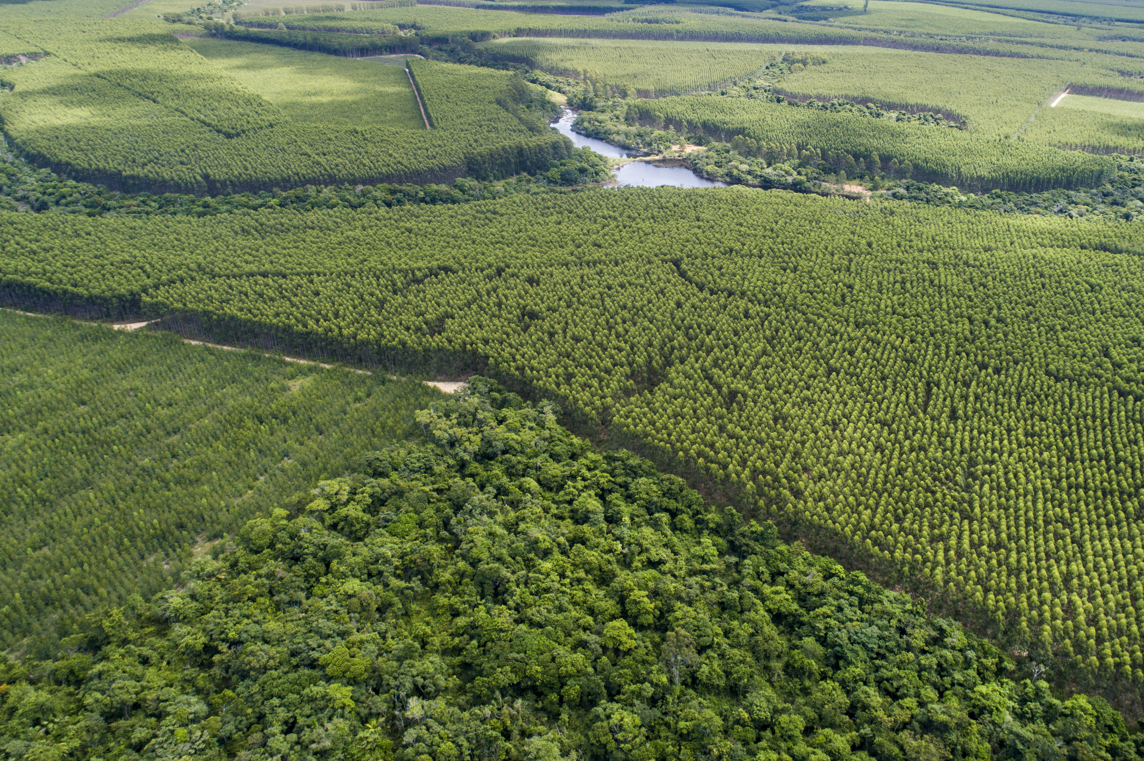

Suzano is one of the World’s largest Paper & Pulp producers and manages a diverse set of process from forestry to distribution of products and consumer goods, underpinned by investment in technology and innovation.
In 2019 they merged with Fibria Pulp, and to realize the vision of the combined company they needed to align two huge portfolios, prioritizing more than 130 Innovation and technology projects into one portfolio.
How could they prioritise this big portfolio quickly and effectively?

Slide 2


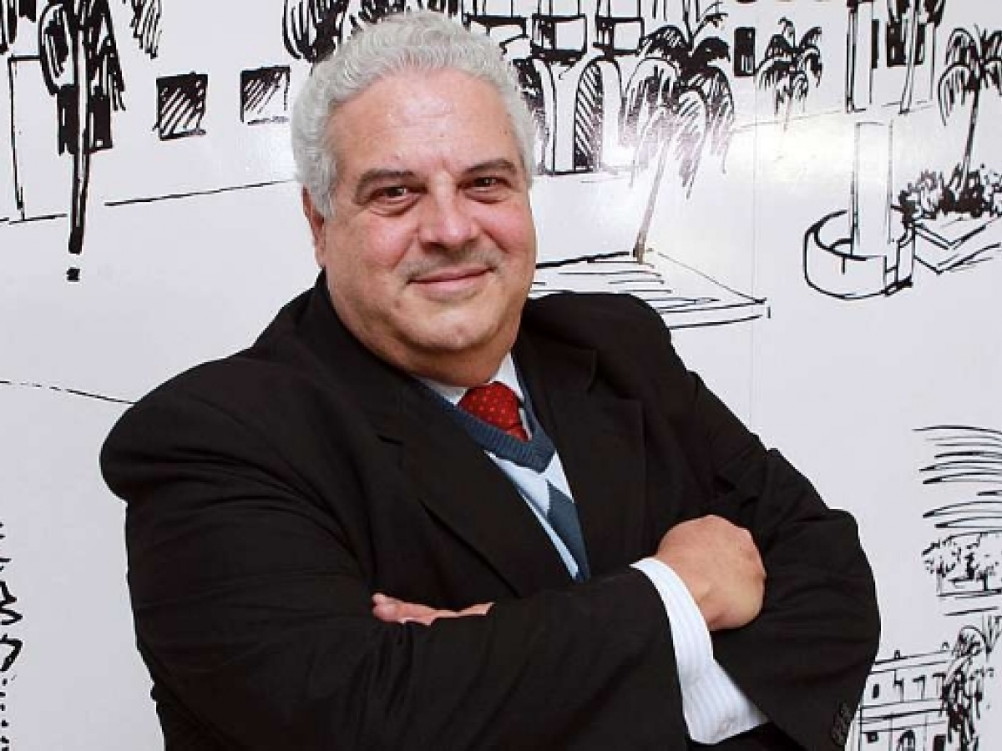
Spreadsheets were not good enough
The criteria were specific to each area
The definition of the criteria involved few people
Scoring was impacted by unconscious bias
The method was empirical and different between areas
Problem
A new process was built with help from an AHP expert…
Professor Roberto Camanho
Decision Science Professor
ESPM São Paulo,
6 Portfolios defined – New Business, Pulp, Paper, Biorefinery, Forest Management & Innovation Process
AHP methodology used to structure criteria and prioritize most viable projects
Redefining project concepts and classifications to support use of AHP
Solution
… powered by an AHP model
Reclassification of projects into 3 types of innovation from Cranfield Grid : Grow the Business, Transform the Business and Run the Business, to ensure that to prioritize projects according to their characteristics
While specific scales & definition were customised, all the models had 3 key themes to provide consistent framework for consideration:
  Strategic Alignment – Fit to high level company goals
  Implementation Risk – Potential issues with Market & Technology
  Market Attractiveness – Market Share & Return on Investment

Slide 3

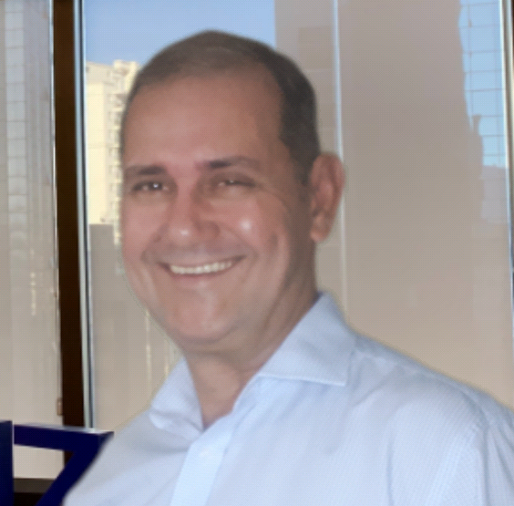
“The process of building an AHP model bought us closer together”
Pulling many R&D Managers and experts together to decide our Criteria really helped us figure out what mattered
Involving experts from other areas of the company gave more credibility to the prioritization process
Bringing people from different backgrounds together to create a shared model was important for the success of prioritization, and helped build understanding of what mattered to different teams across the business
“ We appreciated the improvement in speed”
Having automation from TransparentChoice’s software was 10x faster than relying on manual solutions… the prioritization can be accelerated in remote work using survey mode
…& there is further benefit over time from a maturity curve, as our leaders become confident in using the tool and acting upon the data
“There were 4 key benefits from our collaboration…”
Confidence in decisions grew, built on knowing key prioritization drivers were considered
Standard language across the whole process drove communication
Management could make decisions with confidence, trusting the data as reliable and trustworthy
Project ranking for prioritization decisions created clear outcomes
Plinio C. Ignez
Innovation Management Coordinator
Learn more, with our long-form article on the deployment of AHP into Suzano (coming soon)

