Slide 1


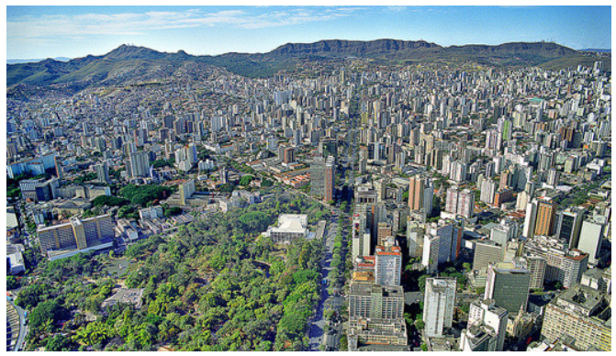
Belo Horizonte was building transport policy & needed to prioritize actions and projects in a multi-year strategic plan
Public engagement was key because this would effect so many peoples’ lives… and it needed to be right so it wouldn’t be changed every few years
More than 5m people live in Belo Horizonte, so integrating their diverse needs into a coherent, deliverable development plan was key to enhancing the quality of life & opportunity for many
LOGIT is a consultancy specialized in transportation planning for cities across the world, and decided to use TransparentChoice to support the delivery this project

Slide 2
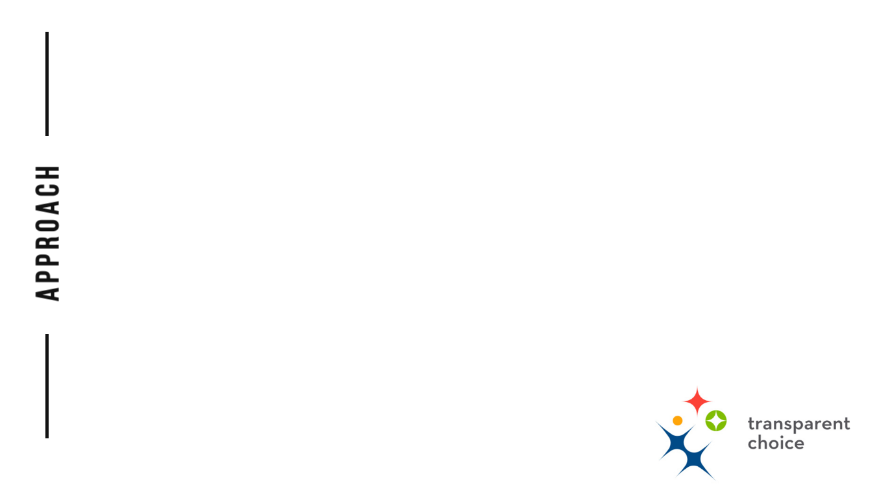
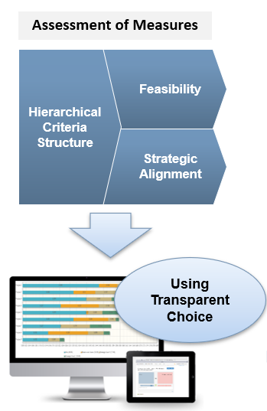
Cognitive mapping process was used to build criteria, through capturing & clustering objectives into AHP framework
Pairwise weighting was completed via public consultation, with >100 people voting, working in small groups to discuss their scores, and then loading them directly into the software
Participation bought together diverse stakeholders, with an open door venue welcoming groups from NGOs, Taxi Drivers & disability groups to local transport agents
230 projects were split into 3 portfolios of similar solutions
Forms sent out to >100 people to vote on the Alternatives,
generating a score for Strategic Alignment
Feasibility was overlayed to factor in finance, social acceptability & difficulty with smaller SME group scoring

Slide 3

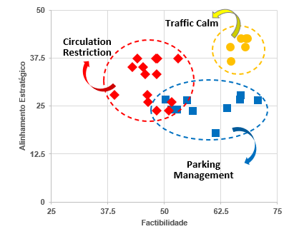
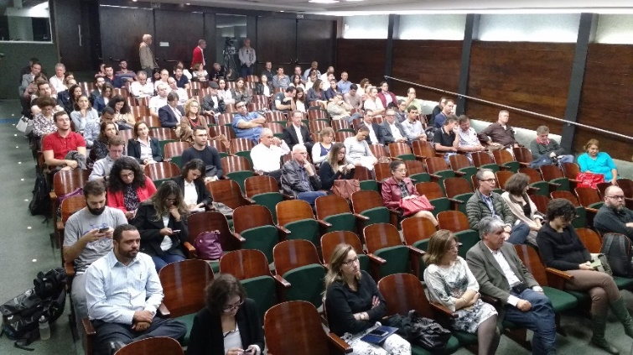

Actionable strategy delivered
Strategic Alignment vs Feasibility matrix split into 3 portfolios – with quick wins identified around Traffic Calming
“You look at the project… to get 230 projects scored with so many people.., and you think that’s impossible to do… but we got it done, and had a very good result”
The client was very very very happy.. They saw that the discussion considered the opinions of everyone
Learn more by listening to Rodrigo’s story on our YouTube channel

